Slide 1
Image Source: Perfectly Boring Media
GCAC Championships on the Rise: 2023-2024 Request for Proposal

Slide 2
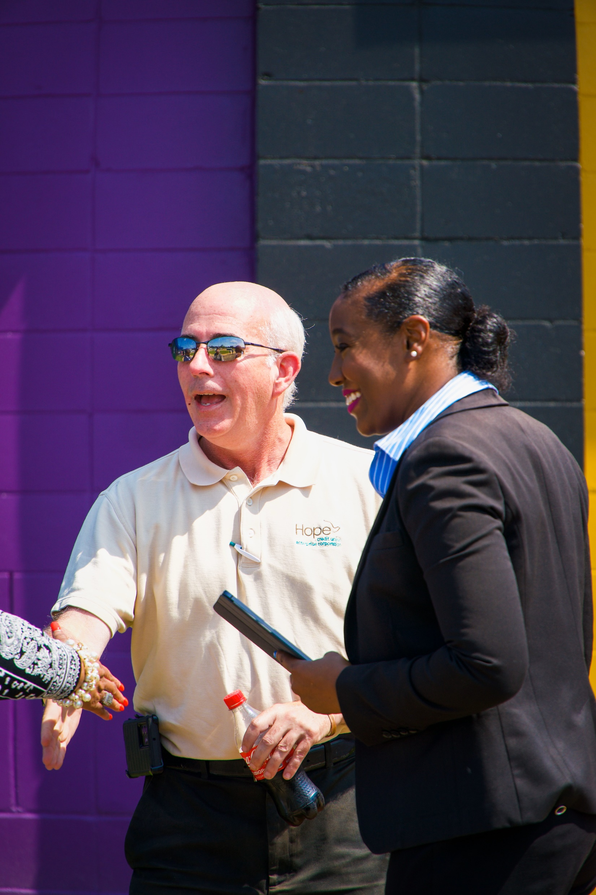
ABOUT the GCAC
The GCAC is a member of the National Association of Intercollegiate Athletics (NAIA). The conference is made up of members representing Historically Black Colleges and Universities (HBCUs) and is only one of five in the United States across all intercollegiate sports made up of HBCU institutions.

Slide 3
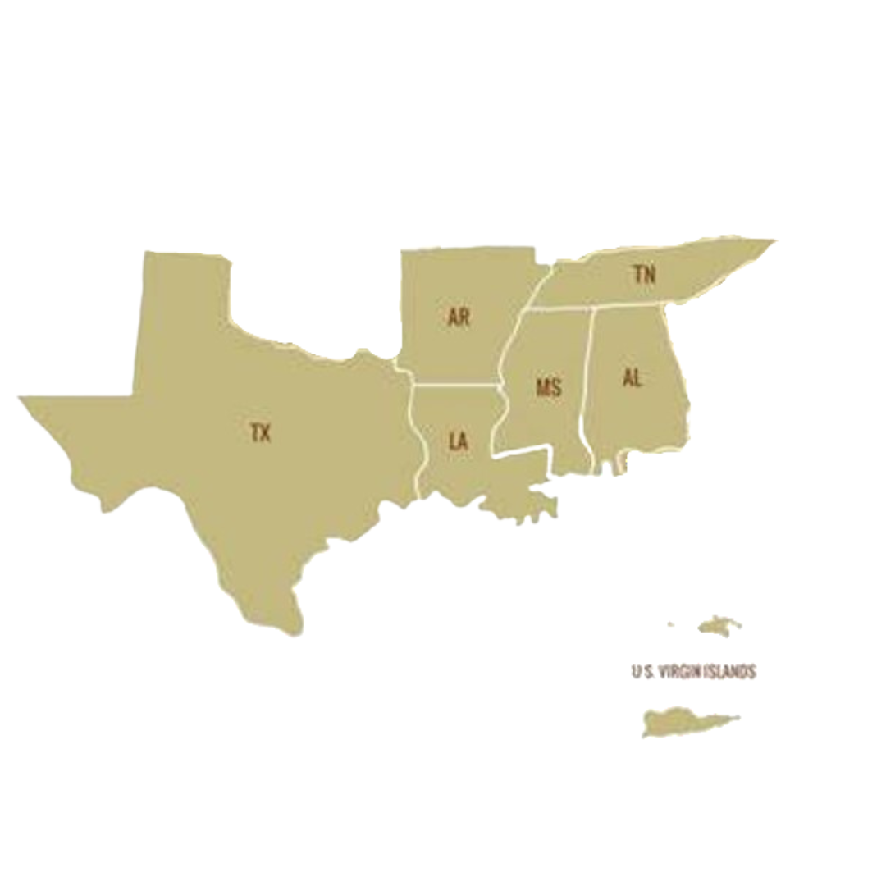
GCAC MEMBERS
Dillard University (LA)
Fisk University (TN)
Oakwood University (AL)
Philander Smith College (AR)
Rust College (MS)
Southern University at New Orleans (LA)
Tougaloo College (MS)
Wiley College (TX)
University of the Virgin Islands (VI)

Slide 4
GCAC MEMBER PROFILES
The athletic programs of the 9 current GCAC members have the following characteristics.
100% Historically Black Colleges & Universities (HBCU)
7 Faith-Based & 2 Public
UNCF & TMF Members
Institution enrollment size: | Average: 952 | Median: 887
Athletics annual budget, operating expenses plus financial aid: | Average: $1 MM | Median: $0.8MM
Total financial aid awarded to student athletes : | Average: $403,000 | Median: $303,000
Unduplicated student-athletes: | Average: 82 | Median: 77
Unduplicated student-athletes as % of enrollment: | Average: 10% | Median: 10%
Budget [operating & financial aid] spent per student-athlete: | Average: $7,400 | Median: $7,800
Financial aid awarded per student-athlete, included in budget: | Average: $5,000 | Median: $4,400

Slide 5
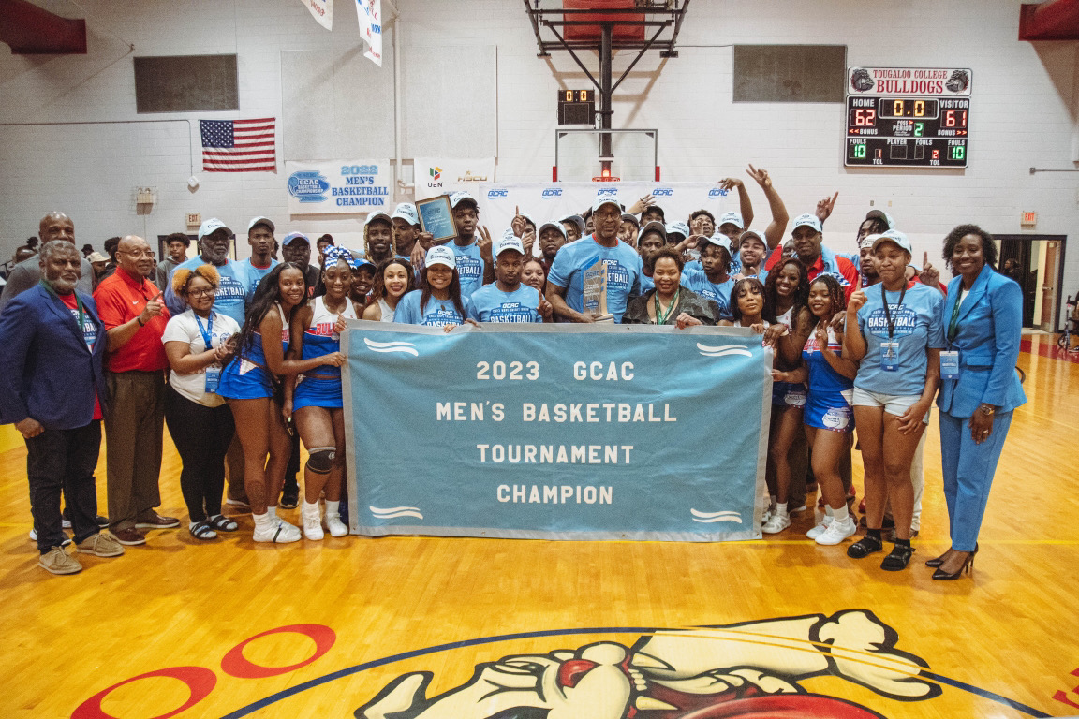

Slide 6
GCAC COMMISSIONER
Dr. Kiki Baker Barnes is an award-winning sports executive in collegiate sports who leads and empowers athletic programs/organizations for growth, provides strategic consulting to national sports organizations and boards and facilitates mentoring and leadership development opportunities for the next generation of women leaders in sports. She is the first African-American female commissioner in the National Association of Intercollegiate Athletics (NAIA).
Her contributions to intercollegiate sports have received national recognition from entities like Sports Illustrated, Medium, HBCU Sports, The Minnesota Spokesman-Recorder, NBA’s New Orleans Pelicans, and Girls Scouts of Louisiana Southeast. She appeared as a Title IX expert on TNT’s “The Arena.” Among her notable accomplishments, she received: the Nike Nell Jackson Executive of the Year by Women Leaders in College Sports (2021); the Under Armour Athletic Director of the Year Award (2019); and Women Leaders in College Sports Administrator of the Year Award (2015).
Dr. Barnes earned her undergraduate degree in communications from the University of New Orleans, a master’s in communications from the University of Louisiana at Lafayette, and a doctorate in higher education administration from the University of New Orleans.

Slide 7
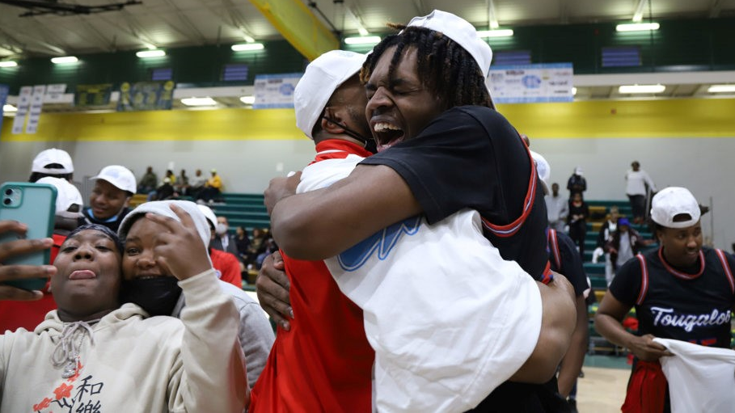
GCAC Championships
“Our goal is to provide a first-class championship event experience for our student-athletes.”
“Our goal is to provide a first-class championship event experience for our student-athletes.”

Slide 8
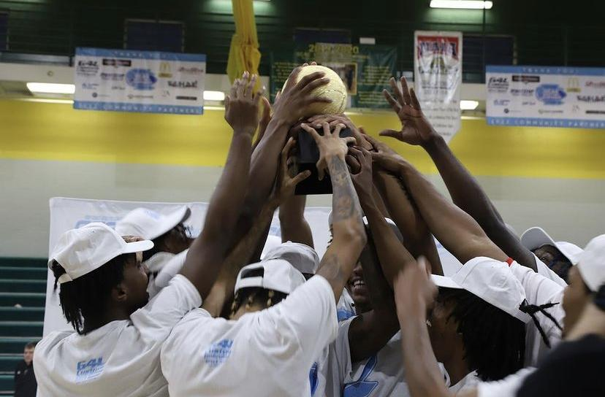
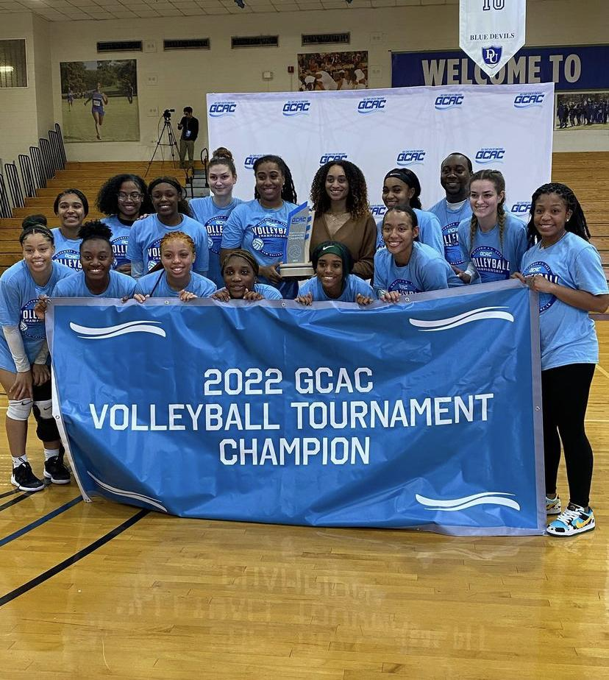
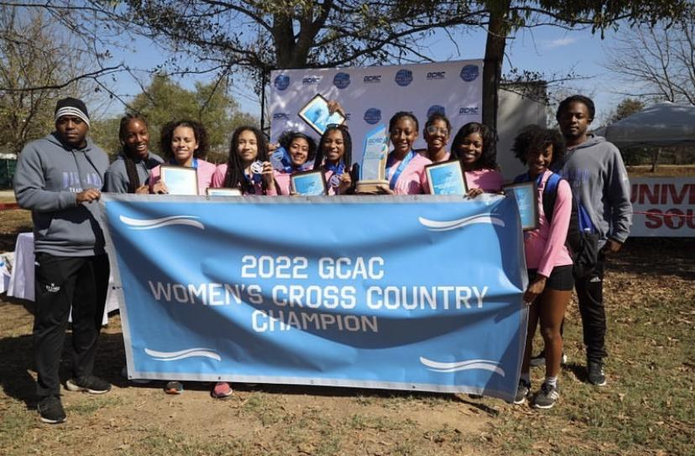

Slide 9
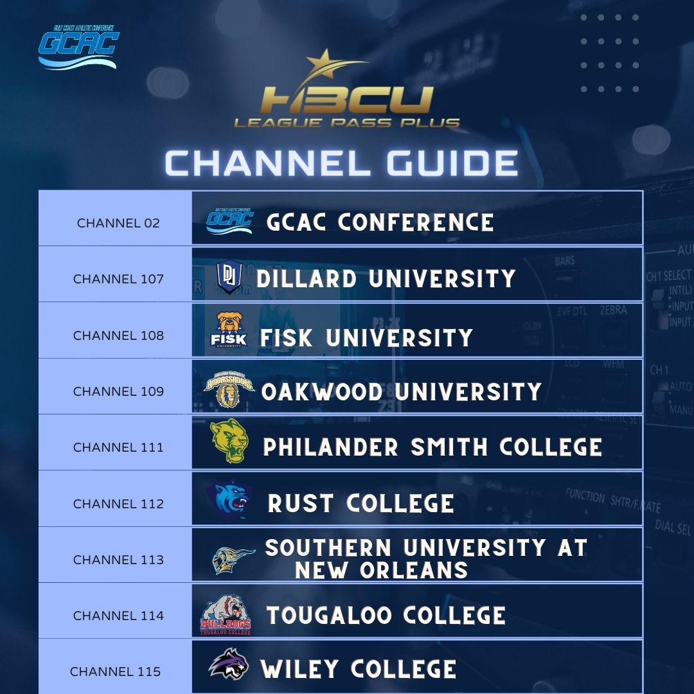
MEDIA RIGHTS
In September of 2022, the GCAC made history by signing the largest media rights deal in NAIA history with Urban Edge Network, Roland Martin’s Black Star Network.
This allows for each GCAC member school to have its own channel and create content that showcases the school’s sporting events, pageants, speeches, talk shows, and much more!
**All GCAC Championships and Media Events are also broadcasted on the app for any and everyone to tune in! For more information, view our conference website and social media handles.
@gcacsports
www.gcaconf.com

Slide 10
GCAC Sponsors

Slide 11
GCAC Partners

Slide 12
GCAC 2023-24 Championship RFP By the Numbers
Conference Championships | Days of Competition | Approximate Travel Party (Student-Athletes, Coaches, Support Staff, GCAC Staff)
Men’s & Women’s Cross Country | 1 day | 170
Women’s Volleyball | 3 days | 370
Men’s & Women’s Basketball | 4 days | 520
 | 8 Total Days | Total of 1,060
GCAC 2023-24 Championships

Slide 13
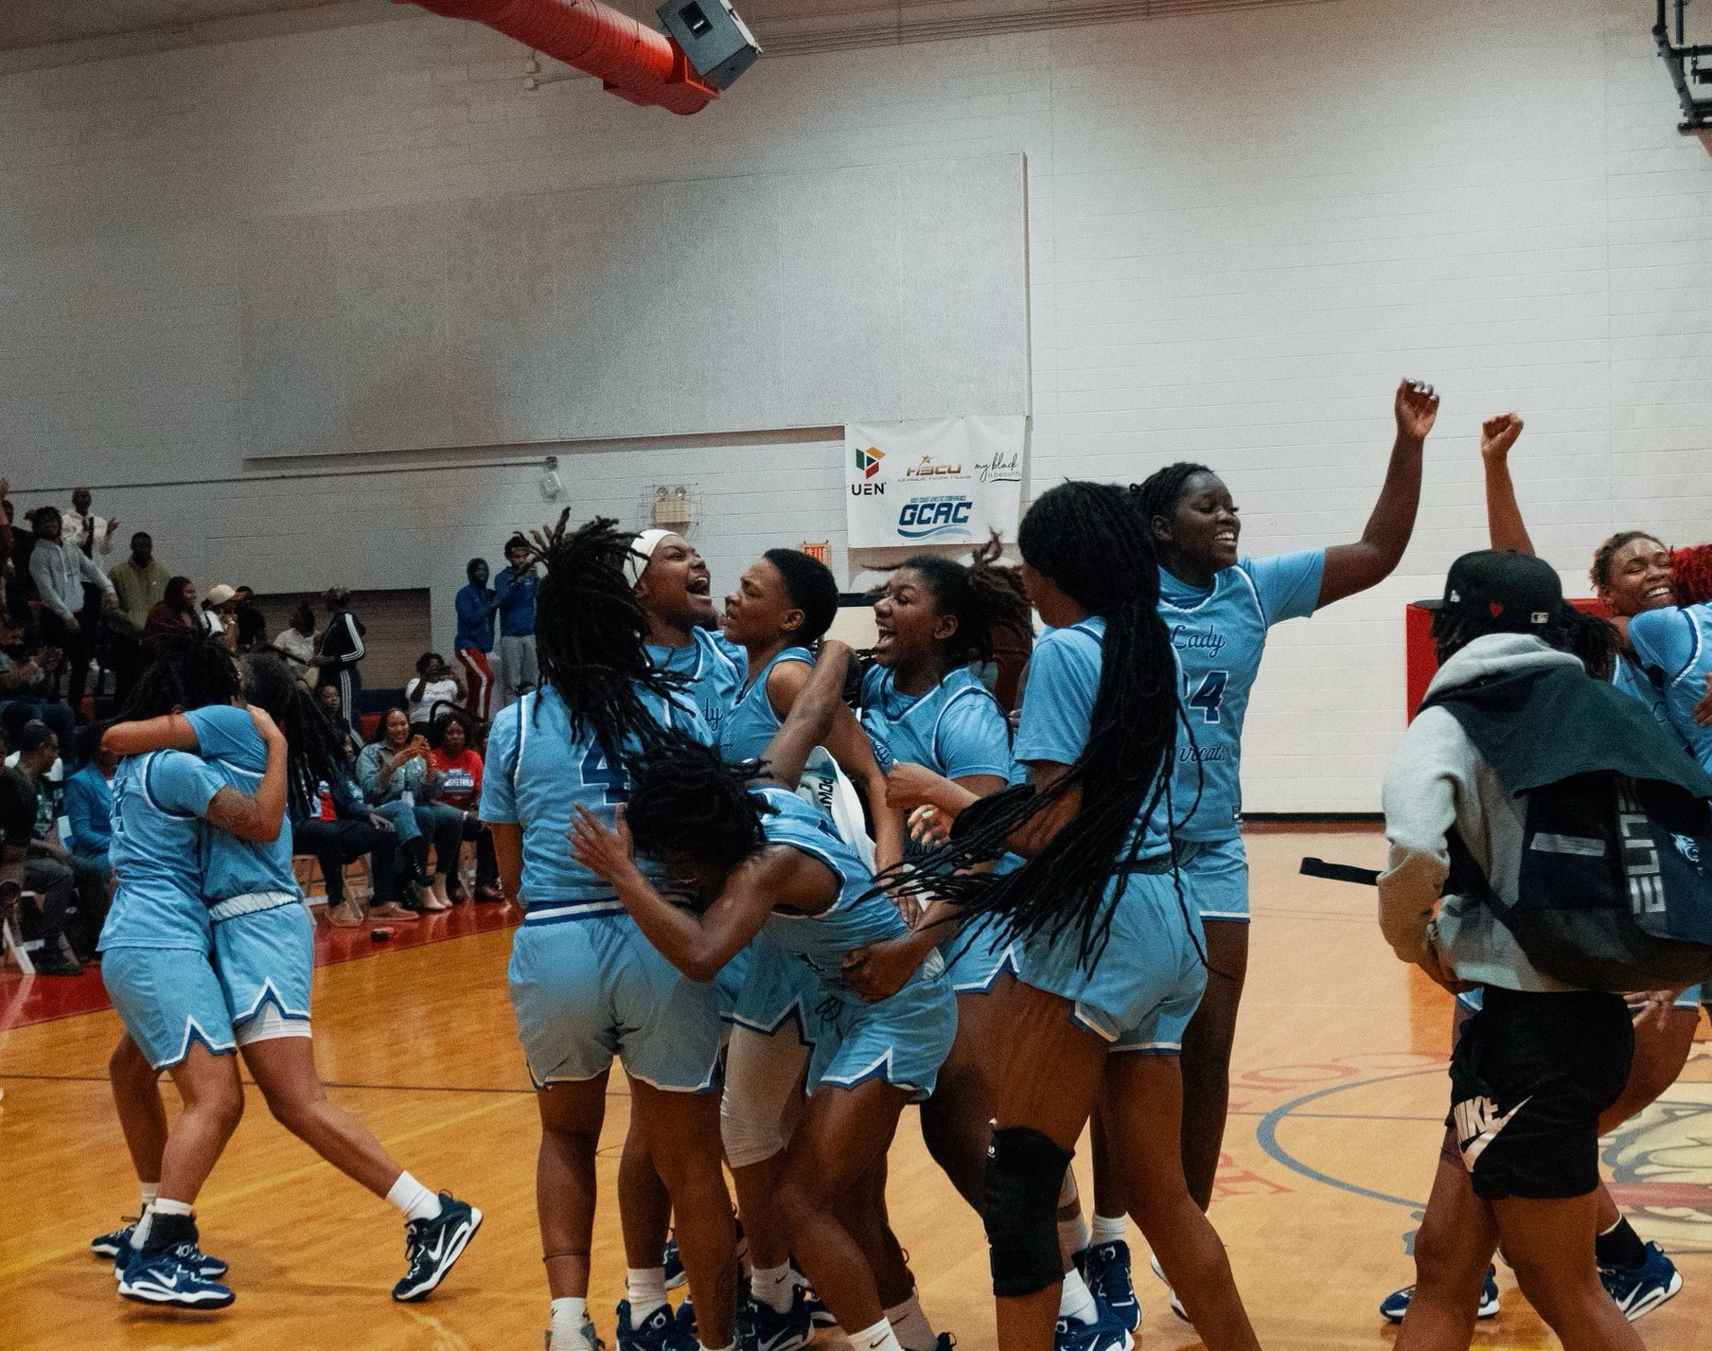

Slide 14
2023-24 REQUEST FOR PROPOSAL
Men’s & Women’s Cross Country Championship
October 20 or 21, 2023
Women’s Volleyball Championship November 2-5 or 9-12, 2023
Men’s & Women’s Basketball Championship
February 21-25, 2024
October 20 or 21, 2023
November 2-5 or 9–12, 2023
February 21–25, 2024

Slide 15
Partner with the GCAC
Proposals are due May 22, 2023.
Interested parties, please contact:
Don Staley
CEO & Founder
Southeastern Network of Athletic Professionals (SNAP)
205-394-0700
dstaley@snapsportstourism.com
2023-24 REQUEST FOR PROPOSAL

